Slide 1
Text Mining: Analyzing Job Postings Case Study

Slide 2
Business Problems To Be Solved:
Types of jobs in demand in Armenia. How are the job natures changing over time?
Desired characteristics and skill-set of the candidates based on the job description dataset. How these are desired characteristics changing over time?
Classification of job as IT or not. Also, understand what important factors are which drives this classification.
Given a job title, find the 5 top jobs that are of a similar nature, based on the job post.

Slide 3
Data Preprocessing
Dropping the feature columns with very high number of missing values - ‘AboutC', ‘AnnouncementCode', ‘Attach', 'Audience', 'Duration', 'Eligibility', 'Notes', 'Salary', 'StartDate', 'Term‘
Imputing missing values in rest of the columns with Mode of the column for categorical features
Dropping the ‘date’ column as ‘Month’ and ‘Year’ are already given

Slide 4
Problem 1: Types of jobs in demand in Armenia.
Features Used : Bigrams of Job Titles on a Yearly Basis
Technique Used to Solve the Problem: Topic Modelling for the above features (on a yearly basis) to give the Top 5 Topics i.e. Jobs in demand every year

Slide 5
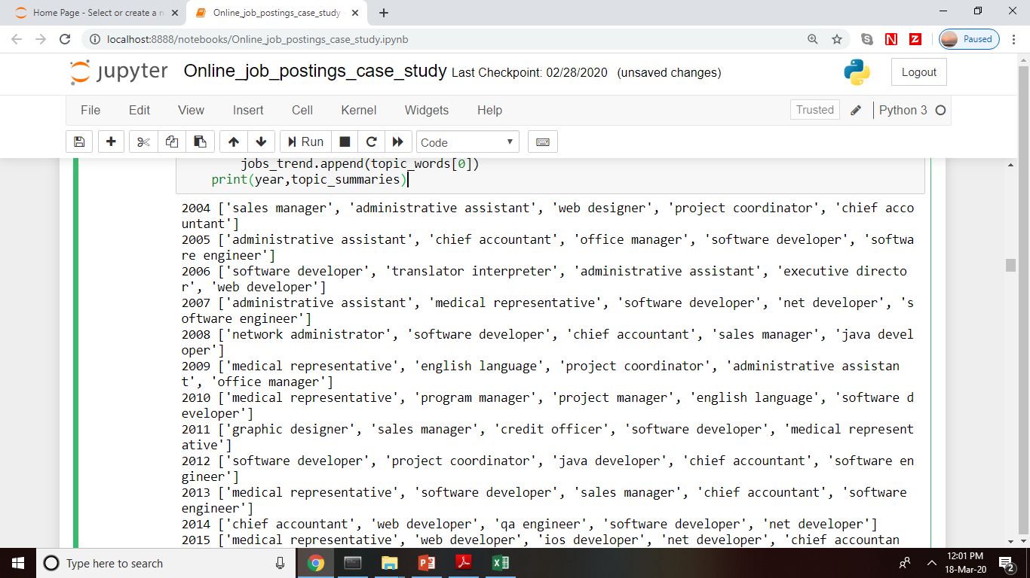

Slide 6
Problem 1: How are the job natures changing over time?
Features Used : Job Titles per year and Jobs in demand as calculated previously
Technique Used to Solve the Problem: Conditional Frequency Distribution in NLTK package to see how Count of jobs in demand are changing over years

Slide 7
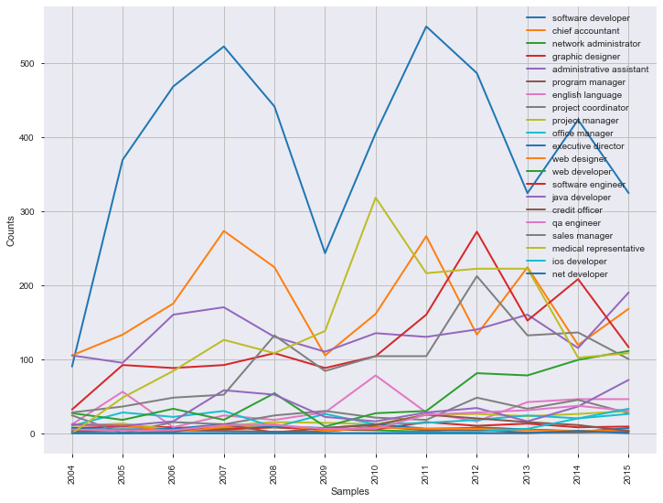
Problem 1: How are the job natures changing over time?

Slide 8
Problem 2: Desired characteristics and skill-set of the candidates based on the job description dataset.
Features Used : Bigrams of the Required Qualifications
Technique Used to solve the Problem: K-Means Clustering followed by Topic Modelling on each unique cluster

Slide 9
Problem 2: Desired characteristics and skill-set of the candidates based on the job description dataset.
Data Preprocessing:
Removing Stop words from ‘RequiredQual’
Removing special characters from ‘RequiredQual’
Removing numbers from ‘RequiredQual’
Removing all other words except Nouns using POS Tagging from ‘RequiredQual’

Slide 10
Problem 2: Desired characteristics and skill-set of the candidates based on the job description dataset.
Modelling Steps:
Making ‘Term Document Matrix (TDM)’ from Bigrams of the ‘RequiredQual’ using ‘TfidfVectorizer()’
Standardizing the TDM using ‘StandardScalar()’
Applying ‘Principal Component Analysis (PCA)’ for Variable Reduction
K-Means Technique for Clustering is used with K (number of clusters) ranging from 3 to 8

Slide 11
Problem 2: Desired characteristics and skill-set of the candidates based on the job description dataset.
Deciding the Number of Clusters (K) = 5 here:
 | QUANTITATIVE ANALYSIS | SILHOUETTE COEFFICIENT | CLUSTER ERRORS
K=3 | 82%,15%,3% | 0.100 | 2883227.60
K=4 | 74%,14%,9%,3% | 0.099 | 2830187.84
K=5 | 74%,13%,9%,3%,1% | 0.101 | 2795948.47
K=6 | 73%,10%,9%,4%,3%,1% | 0.103 | 2764691.96
K=7 | 69%,14%,5%,4%,3%,3%,2% | 0.095 | 2733723.57
K=8 | 55%,18%,10%,5%,4%,4%,3%,1% | 0.070 | 2700762.94

Slide 12
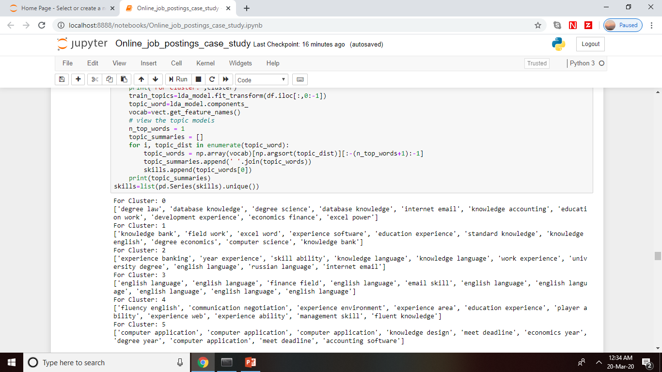
Problem 2: Desired characteristics and skill-set of the candidates based on the job description dataset.
For each of the six clusters, topic modelling is applied to extract the key themes

Slide 13
Problem 2: How are these desired characteristics changing over time?
Features Used : Required Qualifications per year and desired skills/qualifications in demand as calculated previously
Technique Used to Solve the Problem: Conditional Frequency Distribution in NLTK package to see how Skills in demand are changing over years

Slide 14
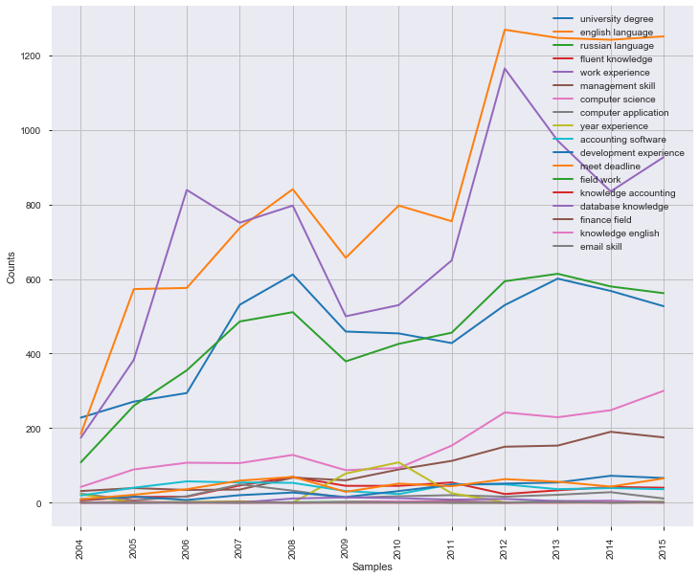
Problem 2: How are these desired characteristics changing over time?

Slide 15
Problem 3: Classification of job as IT or not. Also, understand what important factors are which drives this classification.
Features Used : Unigrams of ‘JobDescription’ and Bigrams of ‘RequiredQual’
Technique Used to solve the Problem: Logistic Regression

Slide 16
Problem 3: Classification of job as IT or not. Also, understand what important factors are which drives this classification.
Data Preprocessing:
Removing Stop words from ‘RequiredQual’ and ‘JobDescription’
Removing special characters from ‘RequiredQual’ and ‘JobDescription’
Removing numbers from ‘RequiredQual’ and ‘JobDescription’

Slide 17
Problem 3: Classification of job as IT or not. Also, understand what important factors are which drives this classification.
Modelling Steps:
Making ‘Term Document Matrix (TDM)’ from Unigrams of ‘JobDescription’ and Bigrams of ‘RequiredQual’
Variable Reduction – Somers’ D for each variable is calculated and significant variables are taken as those with Somers’ D >=0.2
Logistic Regression on Significant variables is applied

Slide 18
Problem 3: Classification of job as IT or not. Also, understand what important factors are which drives this classification.
There are only two significant variables. Therefore, Factors driving the classification of Company as IT or not:
‘Developer’
‘Software’

Slide 19
Problem 3: Classification of job as IT or not. Also, understand what important factors are which drives this classification.
Metrics:
Somers’ D: Train-0.436, Test- 0.460
Accuracy: Train-0.884, Test-0.884
Sensitivity + Specificity: Train- 1.436, Test- 1.460
Confusion Matrix:
TRAIN
PREDICTED-> ACTUAL | 0 | 1
0 | 10601 | 101
1 | 1441 | 1157
TEST
PREDICTED-> ACTUAL | 0 | 1
0 | 4495 | 45
1 | 615 | 546

Slide 20
Problem 4: Given a job title, find the 5 top jobs that are of a similar nature, based on the job post.
Features Used : Unigrams of the JobRequirment after removing special characters, numbers, stop words and lemmatization
Technique Used to solve the Problem: Cosine Similarity

Slide 21
Problem 4: Given a job title, find the 5 top jobs that are of a similar nature, based on the job post.
Modelling Steps:
Making ‘Term Document Matrix (TDM)’ from Unigrams of the JobRequirment
Taking input from user as to which job to search for similarity
Applying Cosine Similarity on above TDM
Sort it in decreasing order of similarity

Slide 22
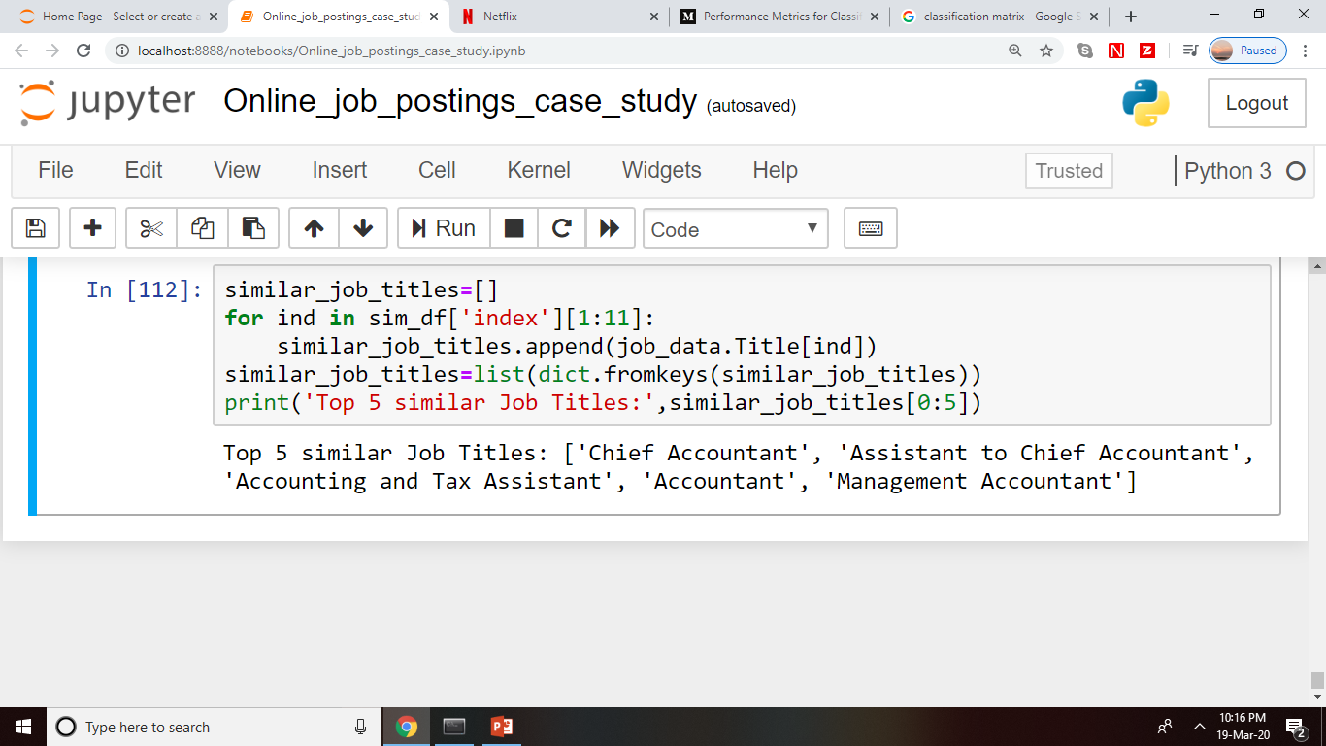
Problem 4: Given a job title, find the 5 top jobs that are of a similar nature, based on the job post.
For input ‘accountant’ similar jobs:

